Slide 1




Automatic Licence Plate Reader (ALPR)
CS 3337, Software Engineering, Fall 2018
Days Worked | LOC Written | LOC/day
11 | 1011 | 84.25
10 | 125 | 12.5
23 | 709 | 31
23 | 725 | 31
Mark Dagraca
Ryan Peralta
Yijie Li
Yiliang Wu
Team Productivity = 68 LOC/day

Slide 2
Member Contribution
Mark Dagraca: Coded Character Recognition module and resource code and provided material for the SRS. Attended 100% of meetings. Set up and organized the codebase Ryan Peralta: Coded object recognition module, provided information for the SRS, edited the SRS, created DFD 0 and DFD 1. Attended 100% of meetings.
Yijie Li: Coded Database Search module and generated data for the database, provided information for the SRS Attended 100% of meetings.
Yi Wu: .Coded GUI module,provided information for the SRS. Attended 96.8% of the meetings.

Slide 3
Project Description
The Automatic License Plate Reader, ALPR, is a program that was designed to detect license plate present in an image and read the plate number.
Law enforcement offices who use the ALPR, will be able to connect their databases to the program and receive alerts when vehicles have any outstanding charges or flags. This will alert the officer using the program to the malfeasance, and prompt him/her to action.
An image of the front or back end of a vehicle will be used as input, and a graphic interface will be used to display a cropped image of the license plate, an edited version of the input image highlighting the plate, and all pertinent information connected to the plate.

Slide 4
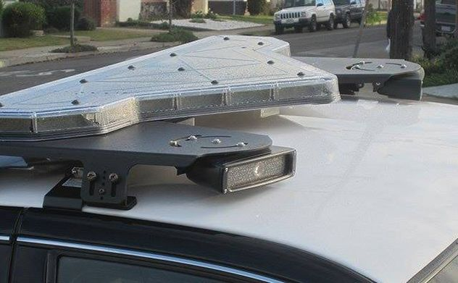
Current Solutions

Slide 5
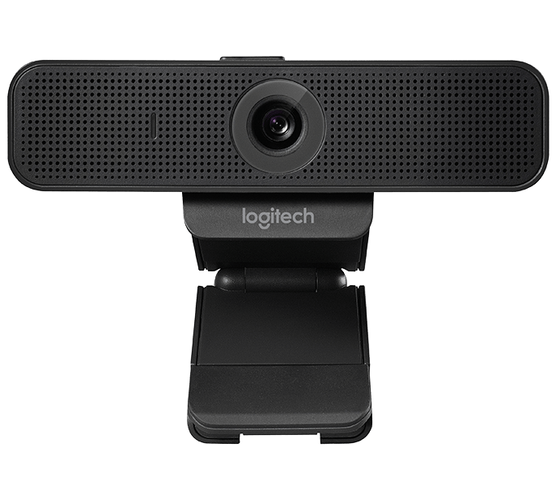
Our Solution

Slide 6
DFD 0
ALPR
Object Recognition
Optical Character Recognition
Communication Function
User Interface
Camera
image
information
User

Slide 7
DFD 1
3.1
User Interface
3.3
Optical Character Recognition
Cropped Image
image
Camera
String text
Cropped Image
Associated Info
3.2
Object Recognition
image
3.4
Mutli DataBase Analyzer
ID#
Associated Info
ID#
Database

Slide 8

Object Recognition Module
Java File object was used as input
Open Source Computer Vision Library
Mat Object
Matrix Header
Pointer to the matrix
Contours
3.1
User Interface
Cropped Image
3.2
Object Recognition
image

Slide 9
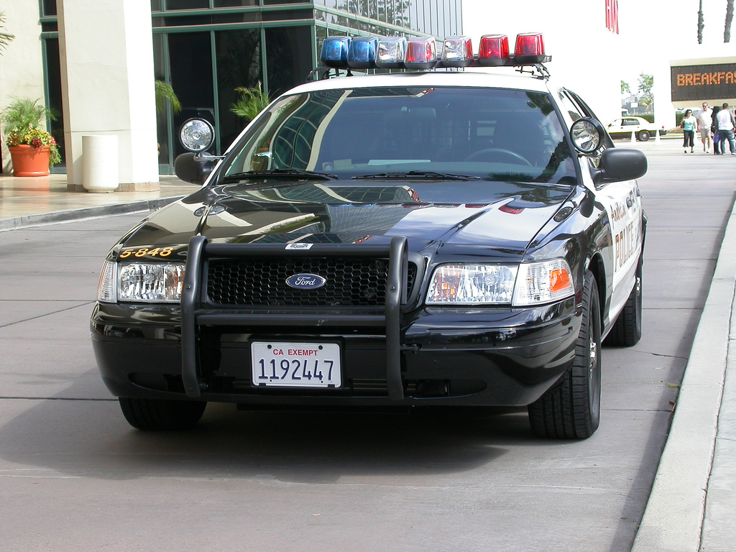
Input

Slide 10
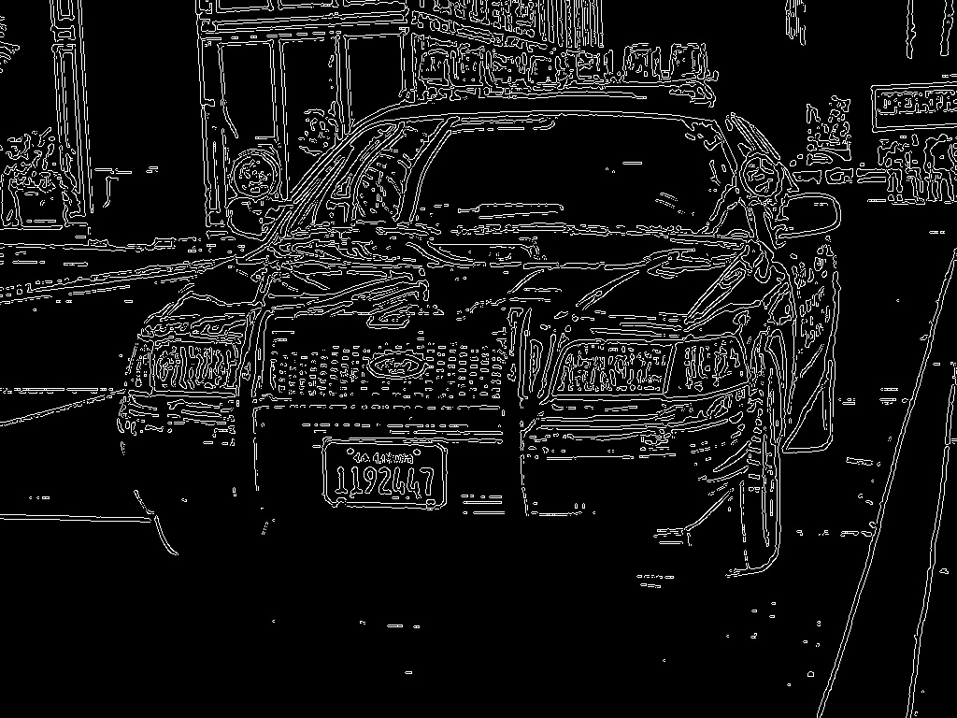
Edge Contour

Slide 11
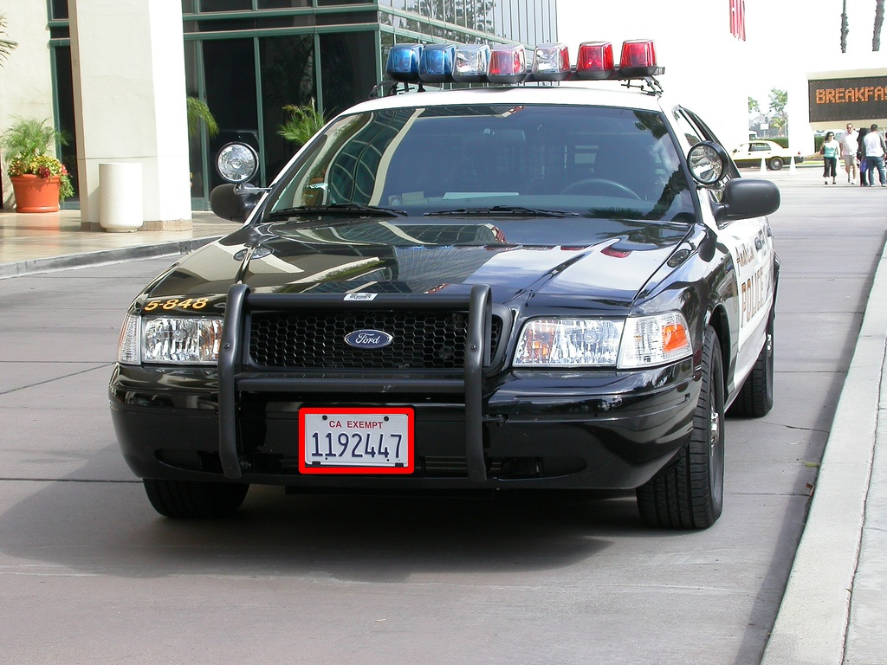
Returned Section

Slide 12

Optical Character Recognition Module
(OCR)
3.1
User Interface
3.3
Optical Character Recognition
Cropped Image
String text
OCR Basic Functional Requirements:
Takes in a cropped license plate image
Analyzes The image for text
Filters out any other text that is not the plate number
Returns the plate number

Slide 13
Input

Slide 14
Scales to 5500px wide

Slide 15
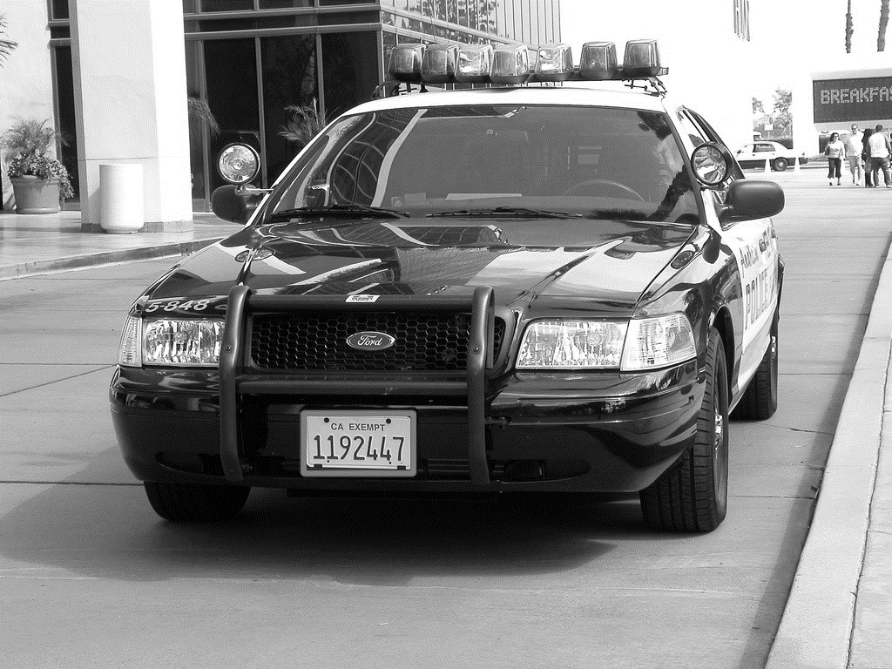
Convert it to black and white

Slide 16
Crops image

Slide 17
Return
1192447

Slide 18
Database Module
User Interface
Mutli DataBase Analyzer
informations
ID#
informations
Database Search Basic Functional Requirements:
Database module receives ID information from the GUI
It searches ID from multiple databases including vehicle
information database, owner information database, and crime database
It returns all informations to the GUI
If the ID information can not be found in the database, it returns null to the GUI
ID#
Databases

Slide 19
GUI Module
Combines all images from previous modules
Displays information from database in a clear and easy to understand way
If any charges/fees are found connected to the license plate, and alert will pop up

